Slide 1
Data Base Management System
(DBMS)
Unit -1

Slide 2
Data Base Management System
Data: Data is the basic raw facts and figures
Ex: a name, a digit, a picture etc.
Data Base: Collection of related data
  Ex. the names, telephone numbers and addresses of all the people you know
Data Base Management System:
A DBMS is a set of programs that controls creation, storage, management, and retrieval of data in a database.
Ex: MS-Access, Oracle, MY SQL, Sybase, IBM DB2, Ingres etc

Slide 3
Use of DBMS
Corporate
Airlines
Hotels
Banks
Colleges /University
Railway reservation
Telecommunication Industry
Data mining
Libraries

Slide 4
Advantages of Using DBMS
No Data Redundancy
Data Consistency
Mass Data Storage
Centralized Access
Automatic Backup Possible
Data Recovery Possible
Integrity Constraints
Easily updation & fetching of data
Only authorized Access

Slide 5
Disadvantages of Flat File Systems
No centralized control
Data Redundancy
Data Inconsistency
Data can not be shared
Standards can not be enforced
Security issues
Integrity can not be maintained
Data Dependence

Slide 6
Data Base Characteristics
Controls data redundancy.
Enforces user defined rules.
Ensures data sharing.
It has automatic and intelligent backup and recovery procedures.
It has central dictionary to store information.
Pertaining to data and its manipulation.
It has different interfaces via which user can manipulate the data.
Enforces data access authorization.
Represents complex relationship between data.

Slide 7
Classification of DBMS
Relational DBMS:
  Modeling concept: tables and constraints on tables
  Query Language: SQL
  Applications: suited for traditional business processing
Object-Oriented DBMS
  Modeling concepts: objects, classes, inheritance
  Query Language: object oriented OQL
  Applications: suited for CAD databases, CASE databases, office automation
Object-Relational DBMS:
  Incorporate OO concepts into relational model
  Similar functionality as OO-DBMS, but different implementations
  Language: extended to process objects.
XML DBMS

Slide 8
DBMS Overview
user
Applications/queries
Query processor
Storage manager
metadata
data
Data: collection of interrelated information about world being modeled
DBMS: general-purpose software to define, create, modify, retrieve, delete and manipulate a database

Slide 9
Data Base Users
DBMS designers and implementers
Database administrator (DBA)
  “superuser” of a database, similar to a system administrator.
  Define schemas, views, authorization, indexes, tuning parameters, etc.
Application programmers
End users

Slide 10
Roles of Data Base Administrator
A database administrator (DBA) is a person responsible for the design, implementation, maintenance and repair of an organization's database. The key roles of a DBA are :
To Provide space to each user.
To create the external and logical Schema.
To Provide security from unauthorized access.
To grant permissions to the user
Installation, configuration and upgrading of Oracle server software and related products.
To take Back up and Recovery of data.
Performance monitoring of the machine and database.

Slide 11
Data Abstraction
Hiding system complexity and physical storage details from users and applications
Customized view
(External level)
View1
View 2
View n
Conceptual representation
Logical Level
Physical data description
(Internal level)
Physical level

Slide 12
Three-Layer Abstraction
External Schema - 1
External Schema - 2
External Schema - 3
Conceptual Schema
Physical Schema
Disk

Slide 13
Description of Levels
Users Level:
Any number of users may exists in this view.
Different users may have different external views for the same data.
It insulates the users from the details of internal & conceptual level.
Conceptual Level:
This level is designed by data base administrator.
Under this level a schema of data base is created by DBA.
It represents the entire database and there can be only one conceptual view per database.
It represents entities, their attributes and relationships between them.
It is independent on the hardware and software.
This is also known as Logical Level.
Internal Level:
It indicates how the data will be stored ad describes the data structures and access methods to be used by data base (ie. The physical implementation of data).
It is concerned with storage space allocation, indexes, data compression etc.

Slide 14
Data Independence
When a schema at a lower level is changed, only the mappings between this schema and higher-lever schemas need to be changed in a DBMS that fully supports data independence.
The higher-level schemas themselves are unchanged. Hence, the application programs need not be changed since they refer to the external schemas.
Disadvantages of two levels of mappings:
Overhead during compilation or execution of a query or program

Slide 15
Mapping between views
Two mappings are required in a databse system with three different views:
Mapping between conceptual and external view
Mapping between internal and conceptual view
Mapping between views specifies the methods of deriving the record at one level from the record at lower level.

Slide 16
Data Independence
Logical Data Independence: The capacity to change the conceptual schema without having to change the external schemas and their
application programs.
Physical Data Independence: The capacity to change the internal schema without having to change the conceptual schema.

Slide 17
DBMS Interface
Provides users means to interact with database:
  Menu driven interface
  Forms based interface
  Using SQL
  WWW connectivity.

Slide 18
DBMS Languages
Data Definition Language (DDL)
  Used to describe a schema
Data Manipulation Language (DML)
  Used by users to query the DB and change the data
Storage Definition Language (SDL)
  Define the internal storage schema
View Definition Language (VDL)
  Define views

Slide 19
Data Model
Concepts and tools used to describe DB schemas
Examples:
  Entity-Relationship Model
  Relational Model
  Object-Oriented Model (e.g., ODL)

Slide 20
Different Data Models
Flat file
Hierarchical Data Model
Network Data model
Relational Data model

Slide 21
Features of Flat Files
A flat file database is a type of database that stores data in a single table or a file. Placing data in a flat file offers following advantages:
All records are stored at one place
Easy to set up using different office applications
Easy to understand
Records can be viewed or extracted based on simple criteria

Slide 22
Disadvantages of flat files
Potential duplication
Data Inconsistency
No centralized access
Harder to change data format
Poor at complex queries
Poor at authorized access

Slide 23
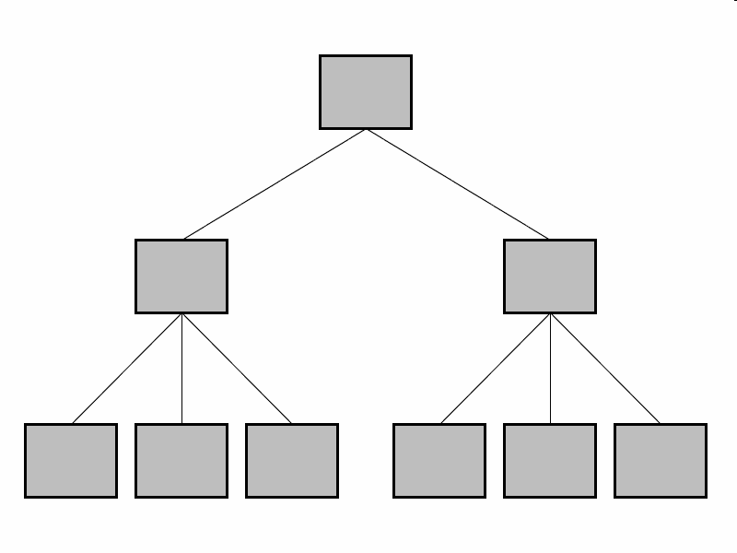
Hierarchical Data Model
In this model data is organized into a tree-like structure, implying a single upward link in each record to describe the nesting, and a sort field to keep the records in a particular order in each same-level list.

Slide 24
Drawbacks: Hierarchical DBMS
Can not handle Many-Many relationships.
Can not reflect all real life situations
Difficult to perform insert, delete and update operations.

Slide 25
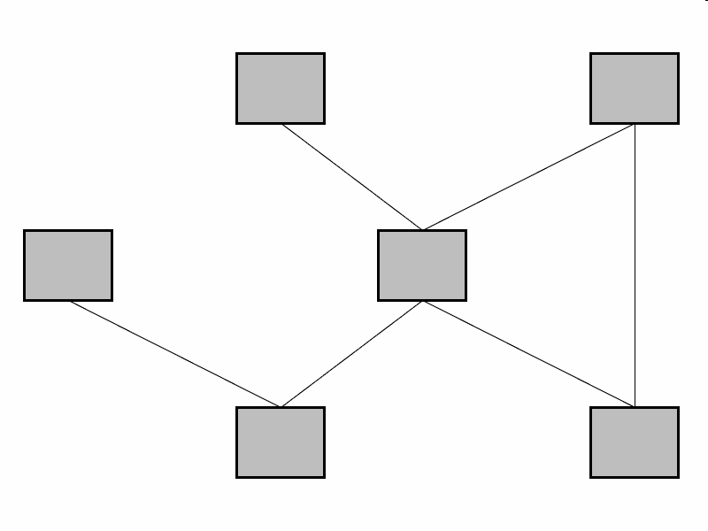
Network Data Model
The basic data modeling construct in the network model is the set construct. A set consists of an owner record type, a set name, and a member record type. A member record type can have that role in more than one set, hence the multiparent concept is supported. An owner record type can also be a member or owner in another set.

Slide 26
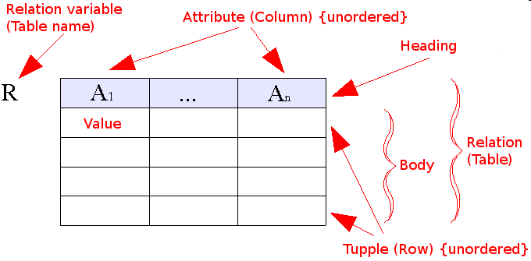
Relational Data Model
Relational model is based on relations of the tables.
It is bounded with 12 codd ’s rules.
Every information is stored in the form of columns and rows.

Slide 27
Relational Data Model
Example of tabular data in the relational model
Attributes
Customer-id
customer-
name
customer-
street
customer-
city
account-
number
192-83-7465
019-28-3746
192-83-7465
321-12-3123
019-28-3746
Johnson
Smith
Johnson
Jones
Smith
Alma
North
Alma
Main
North
Palo Alto
Rye
Palo Alto
Harrison
Rye
A-101
A-215
A-201
A-217
A-201

Slide 28
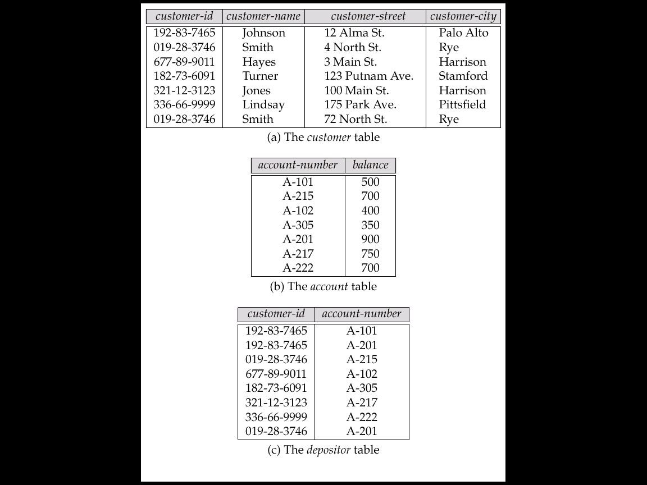
Sample Relational Database

Slide 29
Instance
The collection of information stored in the database at a particular moment is called an instance of the database.
Ex: Amit, 101 etc.

Slide 30
Schema
The overall design of the database is called the database schema.
A schema is the structure of the table which is decided before storing the data.
Example:
Create table student
( rollno number(5),
name char(15),
address varchar2(25));

Slide 31
Tuple
A tuple is a related record stored in a row of the table.
Ex: 101,Alok,MCA,85%
Tuple : Record
Attributes: columns
Entity : Tables

Slide 32
Entity/Relationship (E/R) Model
Entities: objects
Relationships: associate entities
Roles of entities in a relationship
Constraints on entities:
  domain constraints
  key constraints
Constraints on relationships:
  Cardinality constraints
  Participation constraints
  Weak Entity Sets
Multiway relationships
Subclass/superclass Relationships
Aggregation

Slide 33
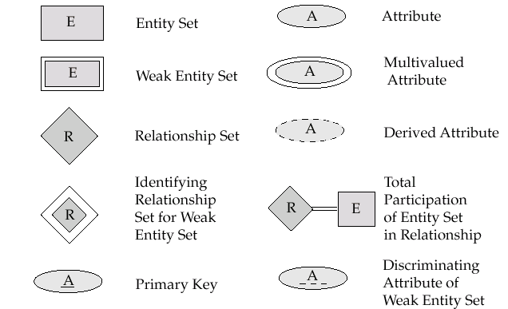
Symbols Used in E-R Notation

Slide 34
Entities and Entity Sets
name
street
number
city
balance
id
Customer
custacct
Account
Entities:
  nouns, “things” in the world
  Have attributes: course name, id, address, dept, age, room, …
Entity sets: a set of entities

Slide 35
Attributes
Single-valued versus multi-valued:
  “telephone number”: multi-valued
  “Salary”: single-valued
Atomic versus composite:
  “Age”: atomic
  “Address”: composite
Derived versus stored:
  Derived: derived from other attributes or entities, e.g., “age” derived from “date of birth.”
  Stored: all other attributes

Slide 36
Relationships
Relationship: association of multiple entities
Relationship Set:
  set of relationships over the same entity sets
  binary, ternary, 4-nary, …n-nary
Custom-Account
Relationship set
account
customer
259, 10K
Tom, 62900, Main, LA
Jane, 62901, North, Irvine
305, 20K
245, 2400
Visualizing relationships as a table. Each row: pair of entities participating in the relationship

Slide 37
ER Diagram
id
name
street
city
balance
number
age
Customer
custacct
Account
dob
tel
opendate
Graphical representation of ER schema. Put as much information as possible.
  Entity set: rectangle
  Attribute: ellipse
  Derived attribute: dashed ellipse (“age”)
  Multivalued attribute: double ellipse (“tel”)
  Relationship set: diamond, with lines connected to its entity sets. May have attributes, called “relationship attributes.”
Not specified how to represent a composite attribute.

Slide 38
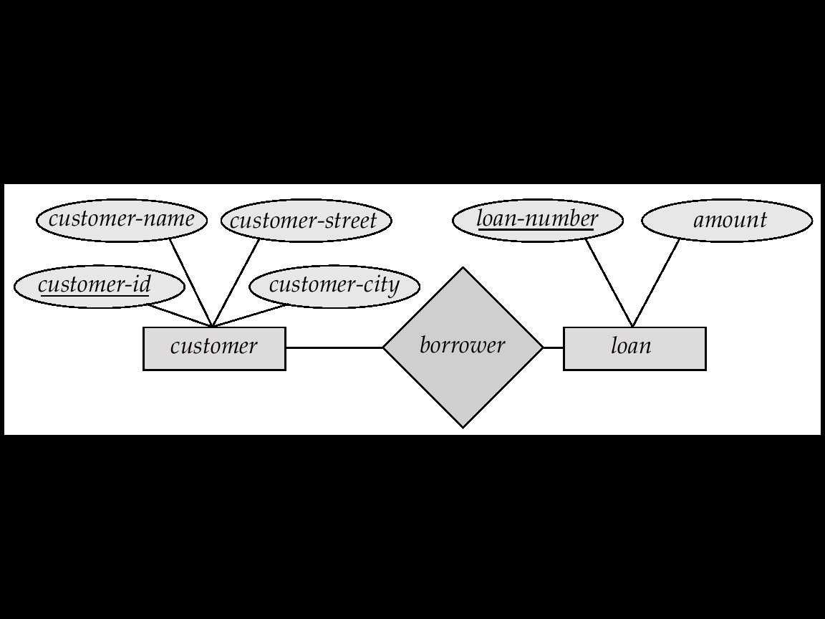
E-R Diagrams
Rectangles represent entity sets.
Diamonds represent relationship sets.
Lines link attributes to entity sets and entity sets to relationship sets.
Ellipses represent attributes
  Double ellipses represent multivalued attributes.
  Dashed ellipses denote derived attributes.
Underline indicates primary key attributes (will study later)

Slide 39
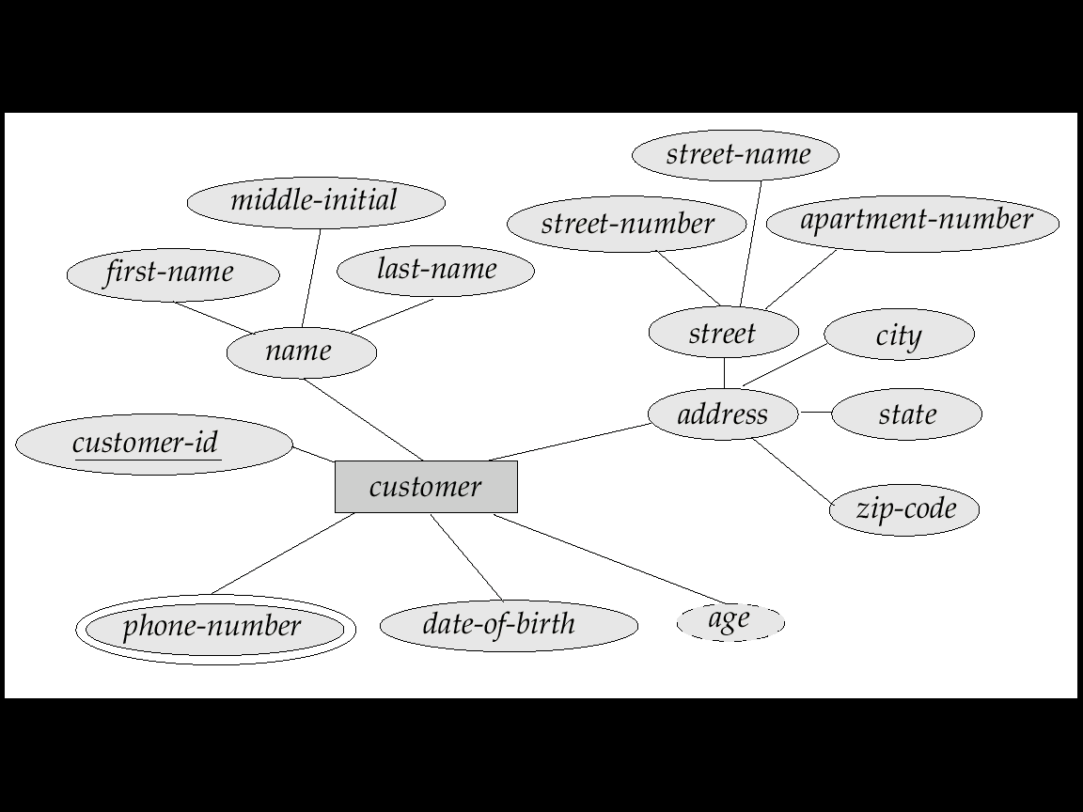
E-R Diagram With Composite, Multivalued, and Derived Attributes

Slide 40
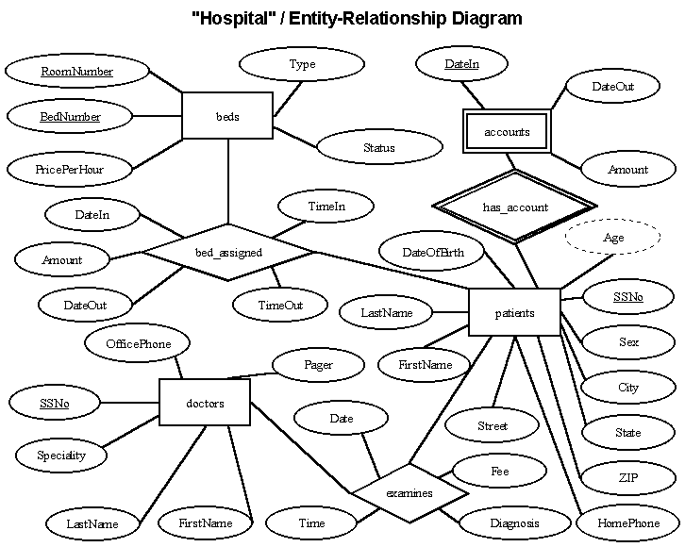
E-R Diagram for Hospital Management System

Slide 41
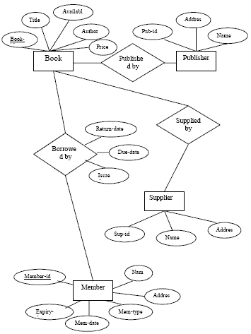
ER Diagram for Library Management System

Slide 42
Types of Keys
Superkey is a set of one or more attributes that allow us to identify uniquely an entity in the entity set. Like: s.no , name ,age
Candidate Key are minimal superkey in an entity, one of those keys is selected to be the primary key
like: s.no and name both
Primary Key is a candidate key that is chosen to identify entities within an entity set
like: rollno
Foreign Key is a primary key of another relation schema like: Any key which is primary key

Slide 43
Roles in a Relationship
Role: the function that an entity plays in a relationship
Needed when entity set is related to itself via a relationship.
manager
employee
works for
worker

Slide 44
Key Constraints on Entity Sets
Associate each entity set with a “key,” which is set of attributes that uniquely identify an entity in entity set.
In ER diagram: denoted by underlining the attributes
Multiple keys possible:
  One primary key is chosen and underlined.
  Other keys, called secondary keys, either not indicated or listed in a side comment attached to the diagram.
dept
name
number
balance
course
student
Account
No two accounts have the same number.
No two students have the same
name in the same dept.

Slide 45
Cardinality Constraints
A
B
A
B
A
B
Many-to-many
Many-to-one
One-to-one
Multiplicity of binary relationship set R between entity sets A and B
Example: For “One-to-one,” an entity in A is associated with at most one entity in B, and vice versa. (A = B = “person”, R = “married-to”)

Slide 46
Many-to-many Relationship
customer
custacct
account
legal
opendate
Multiple customers can share an account
Many accounts may have one owner
(We use customer names as the ids.)
legal

Slide 47
Many-to-One Relationship
customer
N
custacct
1
account
Illegal ☹
opendate
Multiple customers can share an account, but one customer can have only one account.
Represented by an arrow pointing to “one.”
Note: could have no account!
legal ☺

Slide 48
Many-to-One Relationship (cont)
customer
custacct
account
opendate
In a many-to-one relationship, relationship attributes can be repositioned to the entity set on the “many” side.
customer
custacct
account
opendate

Slide 49
One-to-one Relationship
customer
custacct
account
opendate
Illegal
1 customer can have (at most) 1 account.
1 account can be owned by (at most) 1 customer
Relationship attributes “opendate” can be shifted to either entity set.
One-to-one relationship is considered as a special case of many-to-one relationship
Illegal
Legal

Slide 50
Weak Entity Sets
Weak entity sets: they do not have sufficient attributes to form a key.
  They need to “borrow” attributes from other entity sets to form a key.
Example:
  Transactions of different accounts could have the same trans#, so “trans#” cannot be a key
  By borrowing attribute “number” from “account,” we have a key for “transaction.”
  “Transaction” is a weak entity set related to accounts via log relationship.
number
balance
trans#
account
log
transaction

Slide 51
Weak Entity Sets (cont’)
A weak entity set depends upon (one or more) strong entity sets via a one-to-many relationship from whom they derive their key.
The “helper” entity set that provides the attributes is called the “owner” entity set.
A weak entity set may have a discriminator (or a partial key) that distinguish between weak entities related to the same strong entity
Key of weak entity set = key of owner entity set(s) + discriminator
number
balance
trans#
amount
account
log
transaction

Slide 52
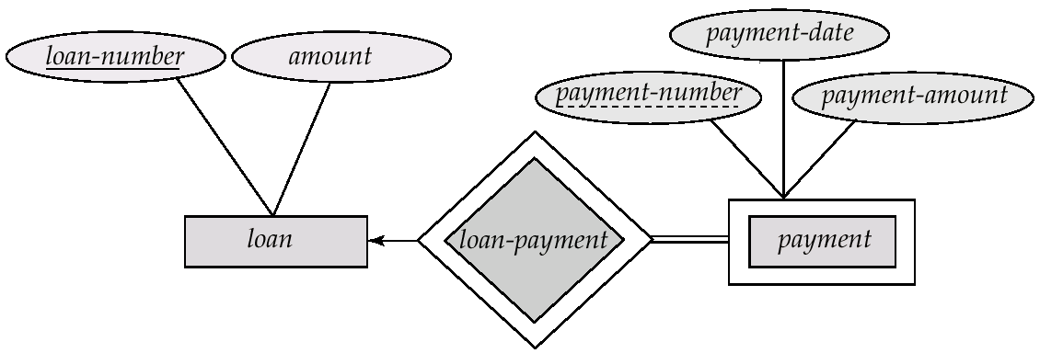
Weak Entity set

Slide 53
Strong entity set
An entity set that has a primary key is termed as strong entity set.

Slide 54

Dr. Edgar F. Codd (1923-2003)
Codd completed his PhD at the University of Michigan in 1963, and presented a thesis on the topic of a self-reproducing computer consisting of a large number of simple identical cells, each of which interacts in a uniform manner with its four immediate neighbors.
Codd reported this work in a book entitled Cellular Automata published by Academic Press in 1968.

Slide 55
12 Codd's Rules

Slide 56
Rule 1 : The Information Rule
All data should be presented in table form.
Rollno | Name | Age | college
10 | Rohit | 20 | Bv
11 | Rahul | 21 | Abes
12 | Amit | 22 | Jss
13 | Simran | 23 | its

Slide 57
Rule 2 : Guaranteed Access Rule
All data should be accessible without ambiguity.
This can be accomplished through a combination of the table name, primary key and column name.

Slide 58
Rule 3: Systematic treatment of null values
A field should be allowed to remain empty. This involves the support of null value, which is distinct from an empty string or a number with a value of zero.
Most database implementations support the concept of a not –null field constraint that prevent null values in a specific table column.

Slide 59
Rule 4: Dynamic on-line catalog based on the relational model
A relational database must provide access to its structure through the same tools that are used to access the data.
This is usually accomplished by storing the structure definition with in special system tables.
These tables are created owned and maintained by the DBMS. They can be accessed by the users in the same manner as ordinary tables, depending on the user’s privileges.

Slide 60
Rule 5 : Comprehensive data sub-language Rule
The database must support at least one clearly defined language that include functionality for data definition, data manipulation, data integrity and data transaction control.
All commercial relational databases use forms of standard SQL( structure Query Language) as their supported comprehensive language.

Slide 61
Rule 6 : View updating Rule
Data can be presented into different logical combinations called views.
Each view should support the same full range of data manipulation that has direct access to a table available.
In practical, providing update and delete access to logical views is difficult and is not fully supported by current database.

Slide 62
Rule 7 : High-level Insert, Update and Delete
Data can be retrieved from a relational database in sets constructed of data from multiple rows and multiple tables.
This rule states that insert, update, delete operations should be supported for any retrievable set rather just for a single row in a single table.

Slide 63
Rule 8 : Physical data independence
The user is isolated from the physical method of storing and retrieving information from the database.
Changes can be made to the underlying architecture ( hardware, disk storage methods) without affecting how the user accesses it.

Slide 64
Rule 9 : Logical Data Independence.
How the data is viewed should not be changed when the logical structure (table’s structure) of the database changes.
This rule is difficult to satisfy.
Most databases rely on strong ties between the data viewed and the actual structure of underlying tables.

Slide 65
Rule 10 : Integrity Independence
SQL should support constraints on user input that maintain database integrity.
At a minimum, all databases do preserve two constraints through SQL.
Primary key should be not null and unique.
If a foreign key is defined in one table, any value in it must exist as a primary key in another table.

Slide 66
Rule 11 : Distribution Independence
A user should be totally unaware of whether or not the database is distributed ( whether parts of the database exist in multiple locations).
A variety of reasons make this rule difficult to implement.

Slide 67
Rule 12: The Non subversion rule
  There should be no way to modify the database structure other than through the multiple row database language( SQL).
  Most databases today support administrative tools that allows some direct manipulation of the data structure.

Slide 68
Subclass/Superclass Relationships
Reason: An ES may have members with special properties not associated with all ES members.
Example: Different accounts have different attributes.
  Checking Account: overdraft amount,
  Savings account: interest-rate.
Possible representations in ER:
  Add an attribute “accountType”: a checking account has a value for the “overdraft” attribute. A savings account has a value for the “rate” attribute.
    Problem: inconsistency; useless attributes; different accounts participate in different relationships.
  Add two columns : IsCheckingAccount and IsSavingAcc:
    The value for overdraft will be stored in IsCheckingAcc column.
    And the interest_rate will be stored in IsSavingAcc column.
    Problems : there will be many NULL values.

Slide 69
Subclass/Superclass Relationships
account#
accounts
balance
ISA
rate
savings
checkings
overdraft
The problems stated previously can be solved by using subclass/superclass relationships.
“Savings” and “checkings” are subclasses of the “account” ES.
“Accounts” is a superclass of savings and checkings ES’s.
An entity in a subclass must belong to the superclass as well.
  Every savings/checking account is also an account.
Attribute Inheritance:
  Subclasses inherit all attributes of the superclass.
  Key of the subclass is the same as the key for the superclass.

Slide 70
Subclass/Superclass Relationships
Superclass and Subclass relationships arise during schema design due to the process of specialization and generalization
Specialization: process of classifying a class of objects into more specialized subclasses
  E.g., start with an employee ES, then specialize it into different types of employees.
Generalization: Reverse of specialization. A process of synthesis of two or more lower-level ES to produce a higher-level ES.

Slide 71
Specialization
An entity set may include sub grouping of entities that are distinct in some way from other entities in the set.
For Instance, a subset of entities with in an entity set may have attributes that are not shared by all the entities in the entity set.
The process of introducing new characteristics to an existing class of objects to create one or more new classes of objects is called Specialization..

Slide 72
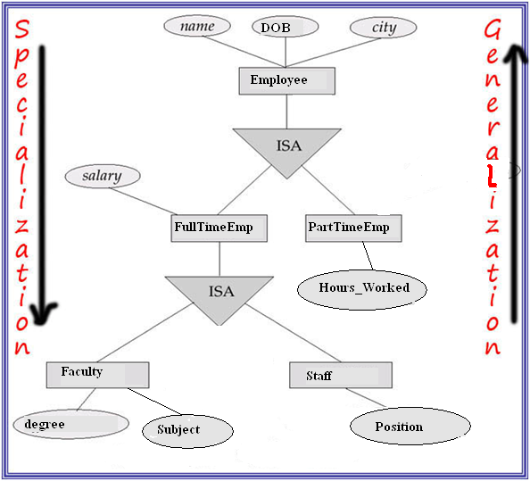
Specialization Example

Slide 73
Generalization
A bottom-up design process – combine a number of entity sets that share the same features into a higher-level entity set.
Generalization is the process of viewing objects as a single general class by concentrating on the general properties of the constituent sets while ignoring their differences.
Specialization and generalization are simple inversions of each other. They are represented in an E-R diagram in the same way.

Slide 74
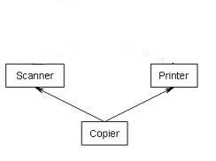
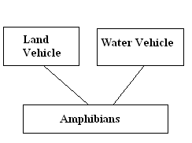
Multiple Inheritance
Subclass inherits all its attributes from its superclass.
If a subclass has 2 or more superclasses, then it inherits from all the superclasses.

Slide 75

Aggregation : Form 1
This represents “whole-part or a-part-of” relationship. This is represented by a hollow diamond followed by a line.
In this type of relationship, a child object does not exist without its parent. And a parent object may contain multiple instances of child object.
Let’s take an example of relationship between Department and Teacher. A Teacher object can not exist independently without the existence of any department. And if we delete any department, the teachers associated with that dept will also be deleted.

Slide 76
Another form of Aggregation
Form 2: It allows a relationship set to participate in another relation.
Express that “an employee works on a specific project possibly using some machines (could be 0).”
Works
employees
projects
machinery
Design 1: incorrect, since it requires each project to use tools.
work
employees
projects
using
machinery
“Design” 2: incorrect, since “relationships of relationships” are not permitted in ER!

Slide 77
Aggregation
work
employees
projects
using
machinery
Aggregation is an abstraction through which relationships are treated as higher-level entities.
Treat the relationship set “work” and the ES’s “employees” and “projects” as a higher-level ES -- an aggregate entity set.
Permit relationships between aggregate entity sets and other entity set.
To create tables out of it : Create a table consisting Primary key of the aggregated relationship & the primary key of the associated entity.

Slide 78
E/R Design Principles
Keep the same schema: Schemas should not change often. So store frequently changing information as instances.
  currently each project consists of 10 members. Since later projects may have more or less employees, do not hard code the 10 employees as 10 attributes of the project entity
Avoid redundancy: schemas should prevent representing the same facts multiple times.
  An attribute/relationship is redundant if deleting it does not result in a loss of any information
  Redundancy may cause:
    wastage of space
    application programming more difficult: need to update all instances of a fact to avoid inconsistency of database
Consistent and clear names for attributes, entities, and relationships

Slide 79
Redundant Attributes
dept #
mgr start date
start date
ssno
departments
manages
employees
Redundant attribute: Managers start date are stored twice.

Slide 80
Redundant Relationship
supplies
suppliers
is-customer-of
items
used-by
projects
The fact that a project is-customer-of a supplier can be derived from the relationships “used-by” and “supplies”:
  A project is-customer-of a supplier if the supplier supplies an item used by the project.

Slide 81
Case Study 1
Design a DB representing cities, counties, and states in the US:
  For states, record the name, population, and state capital (a city).
  For counties, record the name, the population, and the located state.
  For cities, record the name, the population, the located state and the located county.
Uniqueness assumptions:
  Names of states are unique.
  Names of counties are unique within a state (e.g., 26 states have Washington Counties).
  Cities are unique only within a state (e.g., there are 24 Springfields among the 50 states).
  Some counties and cities have the same name, even within a state (e.g., Los Angeles).
  All cities are located within a single county
Notes:
9

Slide 82
Design 1: bad
Co. Popu.
Co. name
Popu.
cities
Located
states
name
Ci. Popu.
Ci. name
capital
Problem: County Population is repeated for each city.

Slide 83
Design 2: good
Co. Popu.
Co. name
Popu.
name
counties
Located
states
Belongs-to
cities
capitals
Ci. Popu.
Ci. name
The population of a county is derived from those of its cities.

Slide 84
Case Study 2
Design a DB consistent with the following facts.
  Trains are either local trains or express trains, but never both.
  A train has a unique number and an engineer.
  Stations are either express stops or local stops, but never both.
  A station has a unique name and an address.
  All local trains stop at all stations.
  Express trains stop only at express stations.
  For each train and each station the train stops at, there is a time.
Notes:
13

Slide 85
Design 1: bad
number
type
time
name
addr
trains
StopsAt
stations
engineer
type
Problem: does not capture the constraints that express trains only stop only at express stations and local trains stop at all local stations
Notes:
15

Slide 86
Design 2: good
number
engineer
train
time
name
d
address
ISA
local trains
StopsAt2
stations
ISA
d
express trains
time
StopsAt1
express stations
local stations
Notes:
16

Slide 87
Short Questions:
Q.1 What is data independence?
Q.2.What do you mean by DBMS?
Q.3 A transaction is a set of operations that must be performed completely or not at all. Explain with suitable example.
Q.4What is the difference between Generalization and specialization?
Q.5 Describe the characteristics of DBMS.
Q.6 Explain all components of E-R Diagram.
Q.7 What is of keys in DBMS and explain how many types of keys are there.

Slide 88
Long Questions:
Q.1 Describe 3-level of abstractions of DBMS.
Q.2 Differentiate between physical and logical data independency.
Q.3 Discuss all 12 rules of Dr. E.F. Codd’s.
Q.4 What is data model? Discuss various data models available in DBMS.
Q.5Differentiate between weak and strong entity sets with example.
Q.6 What is a DBMS? How does it differ from a
conventional file system?

